Slide 1

Call Center Performance Analysis
Created By: Rupsa Chaudhuri

Slide 2

Content
Introduction and Objective
Call Centre Statistics
Agent Performance Overview
Key Agent Insights – Greg
Key Agent Insights - Jim
Quarterly Call Handling Trends
Topics Analysis
SWOT Analysis
Recommended Strategies
Timeline for implementation
Conclusion

Slide 3

Introduction and Objective
Introduction
In today’s presentation, we will delve into an in-depth analysis of our call center's performance. By examining key metrics, agent performance, and quarterly trends, we aim to gain a comprehensive understanding of our current standing and identify opportunities for improvement.
Objective
The objective is to provide a detailed analysis of call center performance, highlighting key metrics, agent-specific insights, and overall trends. This analysis will guide strategic decision-making to enhance operational efficiency and customer satisfaction.
Notes:
Welcome everyone. Today, we will analyze our call center's performance to identify areas of improvement and opportunities for growth.

Slide 4
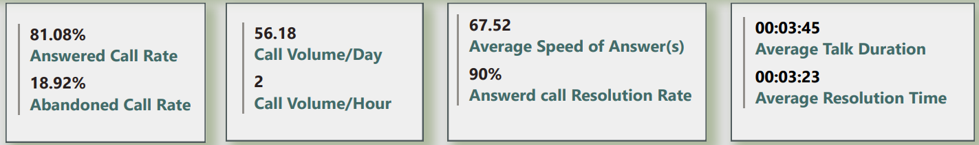
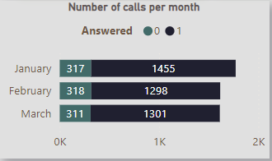
Call Center Performance Analysis
The answered call rate is 81.08%.
The call volume per day is 56.18.
The average speed of answer is 00:03:45.
The resolution rate is 90%.
The average talk duration is 00:03:23.
Most Calls Answered: January '21 (1455 calls)
Most Calls Unanswered: February '21 (318 calls), followed by January '21 (317 calls)
Notes:
High Responsiveness: The answered call rate of 81.08% indicates the call center is responsive to a large portion of incoming calls.
The consistent call volume of 56 calls per day reflects a steady flow of customer interactions.
Potential for Improvement in Efficiency: While the call resolution rate of 90% is positive, the average speed of answer of 3 minutes and 45 seconds suggests room for improvement in call center efficiency. This could lead to longer wait times and decreased customer satisfaction.
Balanced Talk Duration: The average talk duration of 3 minutes and 23 seconds suggests that agents are efficiently handling calls that are answered.

Slide 5
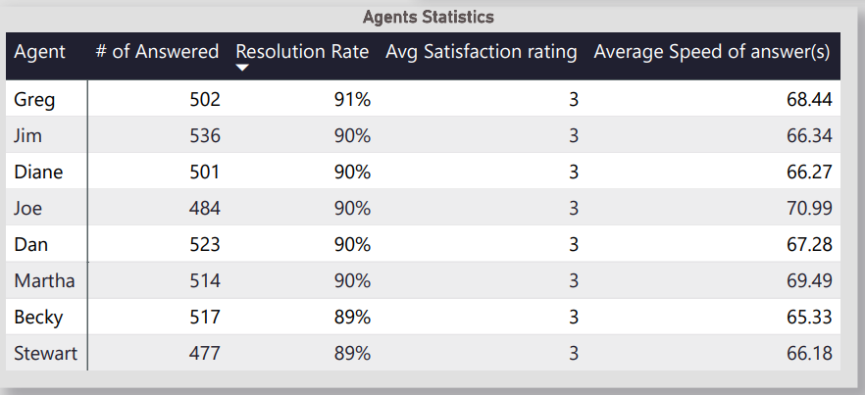
Agent Performance Overview
Greg: Highest resolution rate (91%) and average speed of answer (68.44 seconds).
Jim: Answered the most calls with a resolution rate of 90% and an average speed of answer of 66.34 seconds.
Other Agents: Similar performance with a satisfaction rating of 3.
Notes:
Greg has the highest resolution rate (91%) and the fastest average speed of answer (68.44 seconds). This suggests Greg might be the most efficient agent at resolving customer inquiries.Jim has answered the most calls. However, without additional data on Jim's other metrics (resolution rate, speed of answer, and customer satisfaction rating), it's difficult to assess his overall performance.All other agents appear to have similar performance, based on the limited information provided.

Slide 6
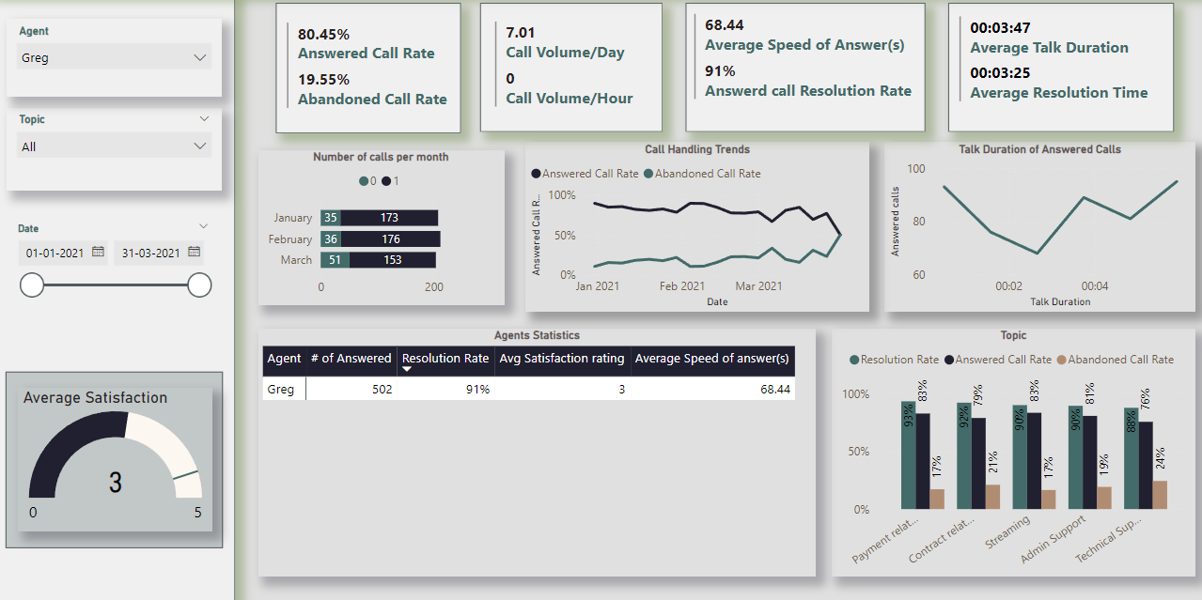
Key Agent Insight- Greg’s Performance
Answered Call Rate: 80.45%
Abandoned Call Rate: 19.55%
Call Volume/Day: 7
Average Speed of Answer: 68.44 seconds
Answered Call Resolution Rate: 91%
Notable Trends:
Answered most calls in February (176).
Highest resolution rate with a talk duration of 2:40 min (93%).
Performance decreased with a drop in answered call rate from 89.47% to 50%.
Resolution rate for payment issues is 93%; for technical support, it is 88%.
Notes:
Greg demonstrates efficiency in handling calls he answers, with a fast average speed of answer and a high resolution rate. He also shows expertise in specific areas, like handling payment-related inquiries. However, there's a concerning decline in his overall performance during Q1. The answered call rate has dropped significantly, and the abandoned call rate has sharply increased. Additionally, Greg's customer satisfaction rating remains below average. We need to investigate the reason behind this decline and provide targeted support to improve his overall performance.

Slide 7
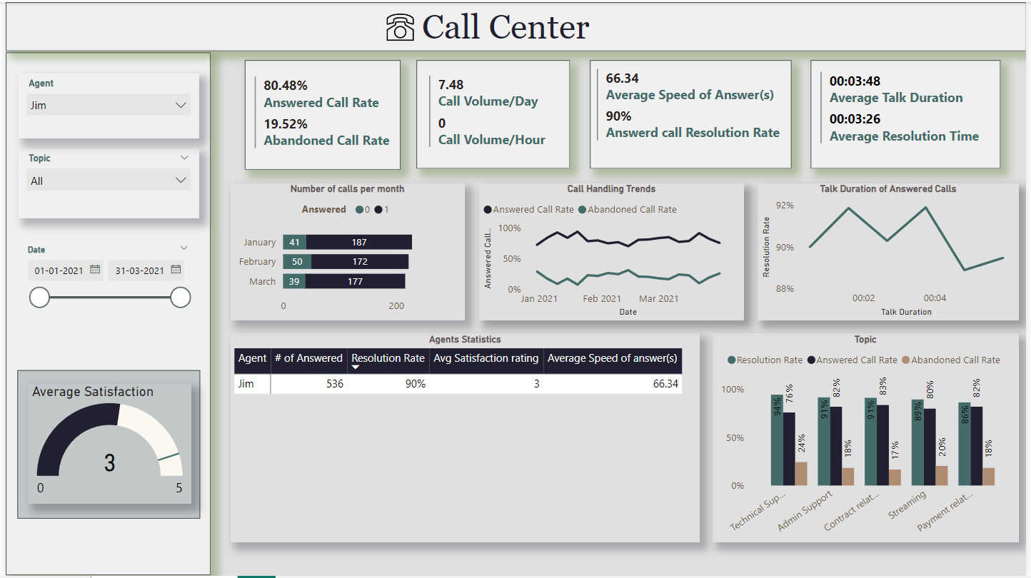
Key Agent Insight- Jim’s Performance
Answered Call Rate: 80.48%
Abandoned Call Rate: 19.52%
Call Volume/Day: 7.48
Average Speed of Answer: 66.34 seconds
Answered Call Resolution Rate: 90%
Notable Trends:
Answered most calls in January (187).
Consistent performance from January to March 2021.
Higher resolution rate for talk durations under 4 minutes.
Resolution rate for technical support is 94%; for payment, it is 86%.
Notes:
Jim demonstrates impressive responsiveness throughout Q1, maintaining a high answered call rate with a low abandonment rate. Customers also tend to be more satisfied with his interactions. Jim's strength lies in handling technical support inquiries, where he achieves a high resolution rate. However, his average speed of answer could be improved to reduce wait times. Additionally, there's an opportunity to enhance his resolution rate for call types other than technical support. By focusing on these areas, Jim can further strengthen his overall performance.

Slide 8
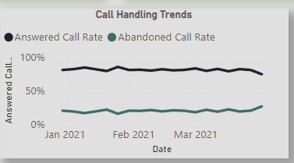
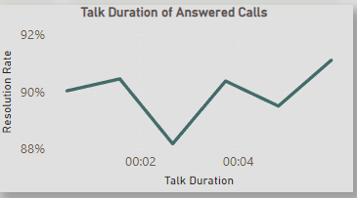
Quarterly Call Handling Trends
Trends
Consistency:
Average answered call rate: 81.08%
Average abandoned call rate: 18.92%
Variation:
Last week of January 2021: Answered call rate of 85.03%, abandoned call rate of 14.97%.
Last week of March: Answered call rate of 74.07%, abandoned call rate of 25.93%.
Talk Duration:
2:40 min talk duration has an 88% resolution rate.
5:55 min talk duration has a 91% resolution rate.

Slide 9
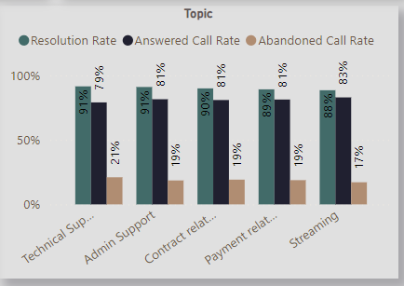
Topics Analysis
Resolution Rates by Topic
Payment Issues:
Resolution Rate: 93%
Answered Rate: 89%
Abandoned Call Rate: 11%
Technical Support:
Resolution Rate: 88%
Answered Rate: 85%
Abandoned Call Rate: 15%
General Inquiries:
Resolution Rate: 90%
Answered Rate: 87%
Abandoned Call Rate: 13%

Slide 10

SWOT Analysis
Strengths
High Resolution Rate: 90% overall, with strong performance in payment issues (93%) and technical support (88%).
Efficient Agents: Top performers like Greg and Jim excel in speed and resolution.
Consistent Call Volume: Steady daily call volume indicating reliable customer interaction.
Weaknesses
High Abandoned Call Rate: 19.55%, indicating a need for improvement.
Performance Drop: Significant decline in answered call rate towards the end of the quarter.
Average Speed of Answer: 00:03:45, suggesting room for efficiency improvements.
Opportunities
Training Programs: Enhance agent skills to reduce call handling time and abandoned calls.
Technology Upgrades: Invest in advanced call routing and automation systems.
Customer Feedback Utilization: Leverage feedback to identify and address service gaps.
Threats
Competition: Rivals may offer faster services, potentially attracting customers.
Operational Costs: Rising costs to maintain high service standards.
Employee Turnover: High stress can lead to higher turnover, impacting service continuity.
Notes:
Strengths
High Resolution Rate: Our call center maintains a high overall resolution rate of 90%, with exceptional performance in resolving payment issues (93%) and technical support inquiries (88%). This indicates that our agents are effective in resolving customer problems and maintaining customer satisfaction.
Efficient Agents: Agents like Greg and Jim demonstrate high efficiency, with Greg having the highest resolution rate (91%) and Jim answering the most calls with a resolution rate of 90%. Their quick average speed of answer further highlights their effectiveness.
Consistent Call Volume: The call center handles a steady volume of calls daily, indicating consistent customer engagement and a stable workflow for agents.
Weaknesses
High Abandoned Call Rate: The call center's abandoned call rate stands at 19.55%, suggesting that a significant portion of customers are not reaching an agent. This can lead to customer frustration and decreased satisfaction.
Performance Drop: There is a notable decline in the answered call rate towards the end of the quarter, with a drop from 89.47% to 50%. This inconsistency needs to be addressed to maintain service quality.
Average Speed of Answer: The current average speed of answer is 00:03:45, which might be considered long by customers and could contribute to the high abandoned call rate.
Opportunities
Training Programs: Implementing targeted training programs can improve agent skills, reduce call handling times, and decrease the abandoned call rate. Continuous training will ensure agents stay updated on best practices and new technologies.
Technology Upgrades: Investing in advanced call routing and automation systems can enhance operational efficiency. AI-driven solutions can help manage routine inquiries, allowing agents to focus on more complex issues.
Customer Feedback Utilization: Establishing a robust system for collecting and analyzing customer feedback can help identify service gaps. Using this feedback to make informed improvements can enhance customer satisfaction.
Threats
Competition: Other call centers may offer faster service and better resolution rates, attracting our customers and impacting our market share.
Operational Costs: Maintaining high service standards and implementing new technologies can increase operational costs. This could impact our profitability if not managed effectively.
Employee Turnover: High stress levels in call centers can lead to higher employee turnover, affecting service continuity and increasing recruitment and training costs.

Slide 11

Recommended Strategies
1. Improve Call Handling Efficiency
- Speed of Answer: Enhance agent training and adjust staffing for quicker response times.
- Callback Option: Implement a callback system to reduce abandoned calls.
2. Enhance Resolution Rates
- Targeted Training: Provide specialized training for common issues like payments and technical support.
- Knowledge Base: Develop and utilize a robust internal knowledge base for agents.
3. Optimize Interaction Quality
- Script Efficiency: Streamline call scripts to ensure clarity and efficiency.
- Real-Time Support: Introduce tools for real-time issue resolution support.
4. Increase Answered Call Rate
- Predictive Dialing: Implement predictive dialing systems for efficient call management.
- Performance Monitoring: Regularly monitor agent performance to optimize call handling.
5.Efficient Call Handling
- Skill-Based Routing: Connect customers with the most appropriate agent.
- First Call Resolution: Focus on resolving issues in the first call.
6. Personalized Service and Feedback
- Customer Profiles: Use data-driven customer profiles for personalized interactions.
- Feedback Loop: Implement post-call surveys and analytics for continuous improvement.
7. Advanced Technology Integration
- AI and Chatbots: Implement AI-driven chatbots for simple inquiries.
- Real-Time Analytics: Use analytics tools for immediate feedback and coaching.
This Photo by Unknown Author is licensed under CC BY-SA
Notes:
### Combined Recommended Strategies Based on Key Metrics and Customer Satisfaction
#### 1. **Reduce Abandoned Call Rate**
- **Improve Speed of Answer:**
- **Training:** Train agents to handle calls more efficiently.
- **Staffing:** Ensure adequate staffing during peak times to reduce wait times.
- **Callback Option:** Implement a callback system for customers who do not want to wait on hold.
#### 2. **Enhance Call Resolution Rate**
- **Focused Training:**
- **Issue-Specific Training:** Provide targeted training for common issues like payment problems and technical support.
- **Problem-Solving Skills:** Enhance training on problem-solving and critical thinking.
- **Knowledge Base:** Develop a comprehensive internal knowledge base for agents to quickly find solutions.
#### 3. **Optimize Talk Duration**
- **Script Optimization:**
- **Efficient Scripting:** Revise call scripts to ensure they are concise and effective.
- **Flexibility:** Allow agents some flexibility to address unique customer needs without unnecessary extensions.
- **Real-Time Support:** Implement real-time support tools to help agents resolve issues faster during calls.
#### 4. **Increase Answered Call Rate**
- **Predictive Dialing:** Use predictive dialing systems to manage call volume efficiently.
- **Monitor Performance:** Regularly monitor and review agent performance to identify and address bottlenecks.
- **Queue Management:** Implement intelligent queue management to prioritize calls based on urgency and importance.
#### 5. **Personalized Customer Service**
- **Customer Profiles:** Use customer data for personalized interactions.
- **Tailored Responses:** Train agents to customize responses based on customer history.
#### 6. **Comprehensive Training Programs**
- **Soft Skills:** Focus on empathy, active listening, and communication.
- **Product Knowledge:** Ensure agents are well-versed in all products and services.
- **Scenario-Based Training:** Use real-life scenarios for training.
#### 7. **Advanced Technology Integration**
- **AI and Chatbots:** Implement AI-driven chatbots for simple inquiries.
- **Real-Time Analytics:** Use analytics tools for immediate feedback and coaching.
- **CRM Systems:** Invest in robust CRM systems for quick access to customer information.
#### 8. **Performance Incentives**
- **Recognition Programs:** Reward high performance and innovative problem-solving.
- **Career Development:** Offer clear career progression paths and development opportunities.
#### 9. **Efficient Call Handling**
- **Skill-Based Routing:** Connect customers with the most appropriate agent.
- **First Call Resolution:** Focus on resolving issues in the first call.
#### 10. **Enhanced Customer Feedback System**
- **Post-Call Surveys:** Implement immediate surveys after calls.
- **Feedback Analysis:** Regularly analyze feedback for improvement opportunities.
- **Actionable Insights:** Use insights for data-driven decisions.
#### 11. **Continuous Improvement Programs**
- **Kaizen Approach:** Adopt continuous, incremental improvements.
- **Regular Training Updates:** Update training based on trends and feedback.
#### 12. **Improved Work Environment**
- **Supportive Culture:** Foster a supportive work environment.
- **Stress Management:** Provide resources for effective stress management.
### Investment Timeline
1. **Short-Term (0-6 months)**
- Implement customer profiling system.
- Launch soft skills and product knowledge training.
- Integrate real-time analytics tools.
- Implement a callback system.
- Start focused training on common issues and efficient call handling.
- Adjust staffing to ensure adequate coverage during peak times.
2. **Mid-Term (6-12 months)**
- Develop and implement an internal knowledge base.
- Revise and optimize call scripts.
- Introduce real-time support tools for agents.
- Implement AI-driven chatbots.
- Establish recognition programs and post-call surveys.
- Start feedback analysis.
3. **Long-Term (1-2 years)**
- Fully integrate predictive dialing systems and skill-based call routing.
- Develop and implement career progression paths.
- Maintain continuous improvement with the Kaizen approach.
- Regularly update training programs and tools based on feedback and performance data.
- Foster a supportive work environment and provide stress management resources.

Slide 12

Investment Timeline
Short-Term (0-6 months)
Implement customer profiling system.
Launch soft skills and product knowledge training.
Integrate real-time analytics tools.
Implement a callback system.
Start focused training on common issues and efficient call handling.
Adjust staffing to ensure adequate coverage during peak times.
Mid-Term (6-12 months)
Develop and implement an internal knowledge base.
Revise and optimize call scripts.
Introduce real-time support tools for agents.
Implement AI-driven chatbots.
Establish recognition programs and post-call surveys.
Start feedback analysis.
Long-Term (1-2 years)
Fully integrate predictive dialing systems and skill-based call routing.
Develop and implement career progression paths.
Maintain continuous improvement with the Kaizen approach.
Regularly update training programs and tools based on feedback and performance data.
Foster a supportive work environment and provide stress management resources.
Notes:
### Investment Timeline
1. **Short-Term (0-6 months)**
- Implement customer profiling system.
- Launch soft skills and product knowledge training.
- Integrate real-time analytics tools.
- Implement a callback system.
- Start focused training on common issues and efficient call handling.
- Adjust staffing to ensure adequate coverage during peak times.
2. **Mid-Term (6-12 months)**
- Develop and implement an internal knowledge base.
- Revise and optimize call scripts.
- Introduce real-time support tools for agents.
- Implement AI-driven chatbots.
- Establish recognition programs and post-call surveys.
- Start feedback analysis.
3. **Long-Term (1-2 years)**
- Fully integrate predictive dialing systems and skill-based call routing.
- Develop and implement career progression paths.
- Maintain continuous improvement with the Kaizen approach.
- Regularly update training programs and tools based on feedback and performance data.
- Foster a supportive work environment and provide stress management resources.

Slide 13

Conclusion
In conclusion, our analysis identifies strengths in a high resolution rate of 90%, particularly in critical areas like payment (93%) and technical support (88%). However, challenges such as a 19.55% abandoned call rate and fluctuations in answered call rates highlight areas for improvement.
To address these, key strategies include:
1. Improving Efficiency: Enhance training and implement a callback system to reduce abandoned calls.
2. Enhancing Resolution: Focus on targeted training and leverage a robust knowledge base for effective issue resolution.
3. Optimizing Interaction: Streamline scripts and introduce real-time support tools for better service delivery.
4. Increasing Answered Calls: Implement predictive dialing and intensify performance monitoring for optimized call management.
5. Efficient Operations: Introduce skill-based routing and prioritize first-call resolution to enhance service efficiency.
These initiatives, supported by ongoing training and technology investments, aim to sustain high service standards and customer satisfaction while addressing operational challenges effectively.
Notes:
In conclusion, our analysis of the call center's performance highlights several strengths and opportunities for improvement. With a high overall resolution rate of 90%, particularly strong in payment issues (93%) and technical support (88%), our agents demonstrate effective problem-solving capabilities. However, challenges such as a high abandoned call rate of 19.55% and fluctuations in the answered call rate underscore areas needing attention.
To capitalize on our strengths and address these challenges, strategic initiatives are crucial:
Improving Call Handling Efficiency: Enhance training to speed up response times and implement a callback system to reduce abandoned calls.
Enhancing Resolution Rates: Focus on targeted training and leverage a robust knowledge base to ensure consistent, effective issue resolution.
Optimizing Interaction Quality: Streamline call scripts for clarity and introduce real-time support tools to enhance service delivery.
Increasing Answered Call Rate: Implement predictive dialing systems and intensify performance monitoring to optimize call management.
Efficient Call Handling: Implement skill-based routing and prioritize first-call resolution to improve overall service efficiency.
These strategies, implemented over a structured timeline, will not only address current weaknesses but also position us to leverage technological advancements and customer feedback for sustained improvement in operational efficiency and customer satisfaction. By fostering a supportive work environment and investing in ongoing training and technology, we aim to enhance service excellence and maintain competitive advantage in the marketplace.

Slide 14

Thank You!
Connect via:
Email: rupsachaudhuri9@gmail.com
LinkedIn
GitHub

